Slide 1


Scott McAllister Engineer @ Patch My PC
Twitter: @ScotScottMcA
Blog: https://scotscottmca.com
Discord: scotscottmca
https://winadmins.io/

Slide 2

We help you integrate third-party patch management in Microsoft ConfigMgr and Intune

Slide 3






Who are we?
19.1+
million
2011
6100+
5
90+
start
customers
endpoints
MVPs
people & growing

Slide 4













Some of Our Customers

Slide 5
57%
Updating is important!
of data breaches could have been prevented by
being patched on time
37%
of companies don’t
scan for vulnerabilities
$4,4 Million
average cost of a data breach
Every
11 seconds
companies are hit by ransomware attacks
Maintains compliance with requirements of
ISO27001

Slide 6







TIME
THE BIGGEST CHALLENGE
=
Check for
update
Create a new package
Release
Test the package
Validate
Deploy to
pilot

Slide 7

3-5 hours per update x
applications
=
Challenge
for an IT admin

Slide 8




Solution
Our average customer saves about 6000 hours per year!
Our Magic
Your Magic

Slide 9




Our Magic → Automated patch management
Scrape vendor websites
Test and verify updates
Deploy updates

Slide 10




Your Magic → set and forget
Install Patch My PC Publisher
Configure your applications
Be secure and compliant

Slide 11








Enhancing ConfigMgr and Intune
Application
update rings
User interaction
when app is in use
Updating available applications
Autopatch
Advanced Reporting
CVE discovery

Slide 12

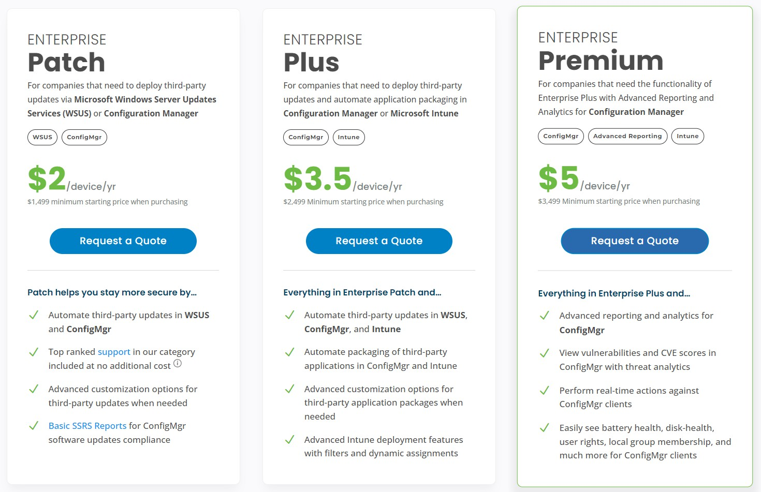
*
For less than a
Enterprise
Patch
Enterprise
Plus
$3.50 per device per year
Enterprise
Premium
$5 per device per year
$2 per device per year
*Per year

Slide 13




Next steps
Enjoy your extra
time
Book your setup call (optional)
Request your
quote
Start your trial

Slide 14



Thanks!
Let’s keep in touch!
sales@patchmypc.com
+1 800 250 2334
https://patchmypc.com
Request a free trial at
patchmypc.com/free
-trial
Book a demo
at
patchmypc.com/sche
dule-live-demo
FAQs
Cost Justification and ROI
patchmypc.com/cost
-justification-and-roi
Docs
docs.patchmypc.com/
Supported products
patchmypc.com/su
pported-products
patchmypc.com/fre quently-asked- questions

